Slide 1
PLACEMENT MANAGEMENT SYSTEM
Presented by :
Name: Lavanya B R
Enrollment Number :EBEON1121471391

Slide 2
Introduction
Spring Boot Project Placement Management Application have Admin, Student, Placement ,College entity .
Admin entity is for login purpose and have a home page to connect with other entities.
Placement, college, student entities have CRUD operation for create, delete ,update and read the details.
Data’s were stored in MYSQL database.
Our Project Include:
Admin module
College module
Student module
Placement module

Slide 3
Software Requirements
Front end: Java/J2EE technologies (Servlet, JSP), HTML, CSS, JavaScript, Bootstrap, Hibernate.
Back end: MySQL workbench 8.0.23CE.
Middleware/Server: Apache Tomcat v8.5. IDE: Eclipse IDE for Java EE Developers
Browser: Best result on Google Chrome
Operating System: Window 10.

Slide 4
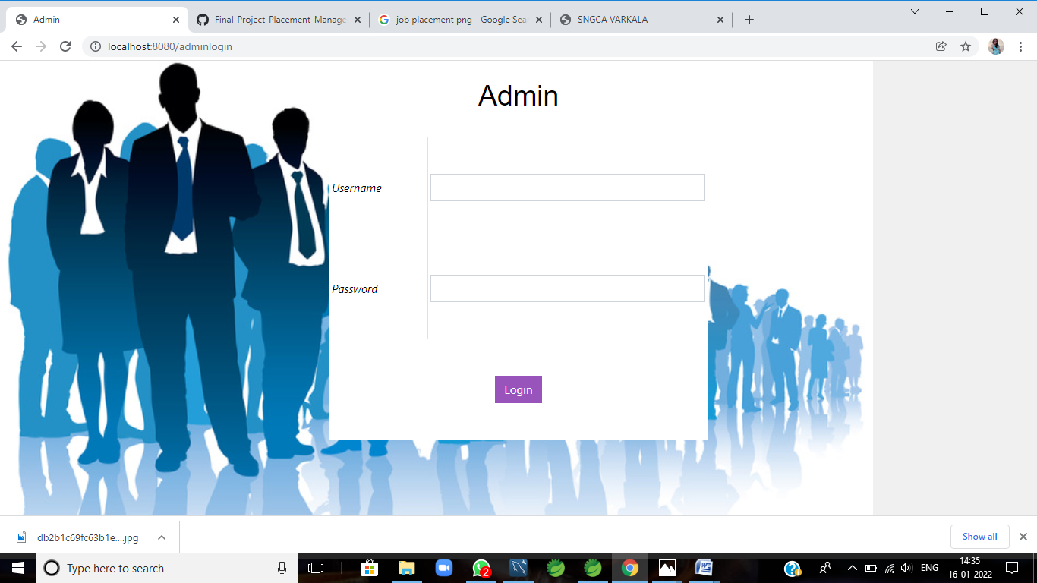
Output Login page

Slide 5
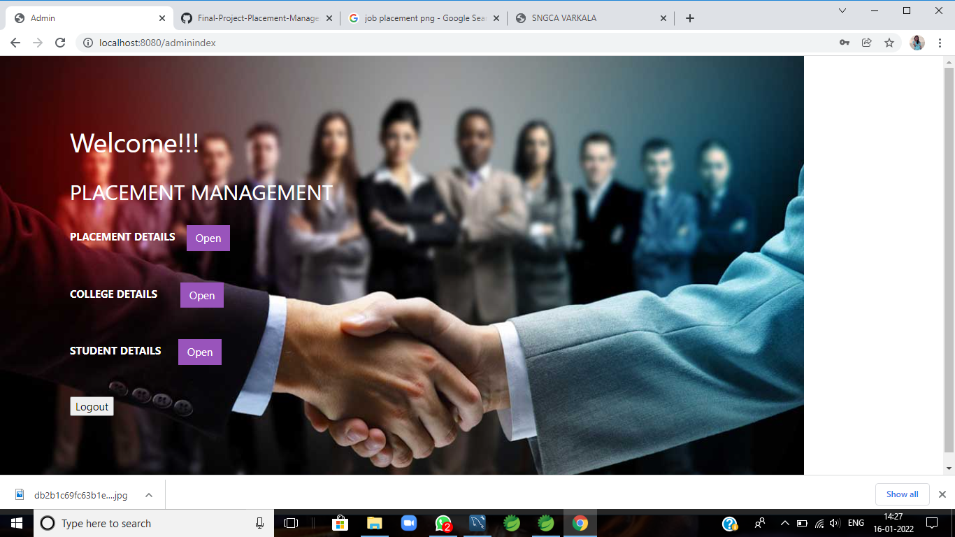
Enter login, it redirects to home page

Slide 6
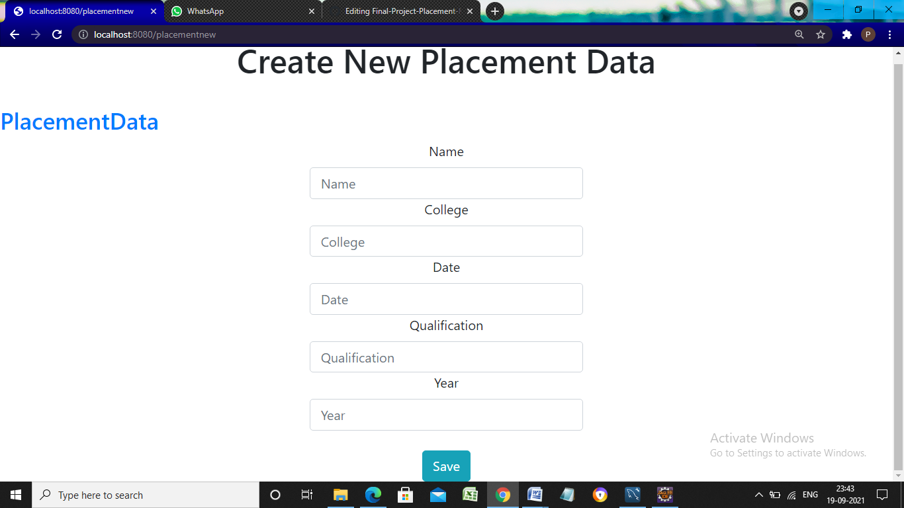
Click open button in Placement details.

Slide 7
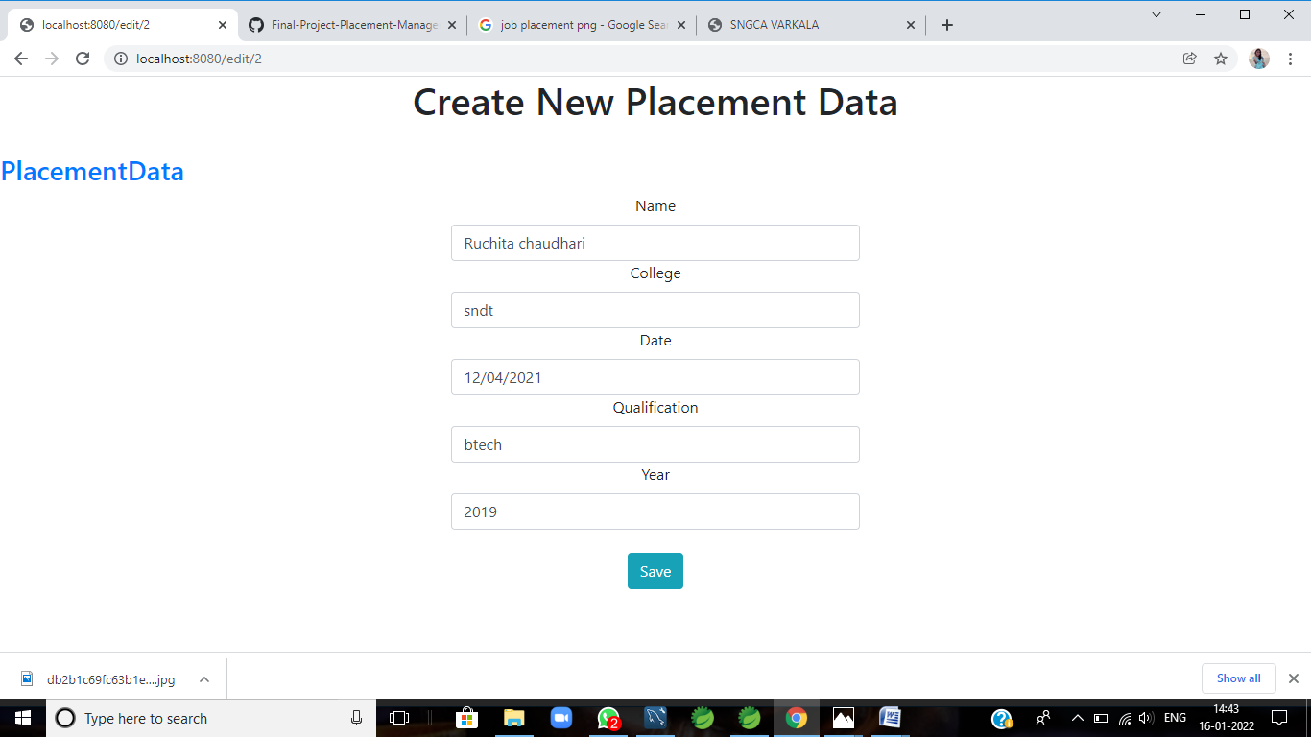
Click Edit,change the details ,save it and updated.

Slide 8
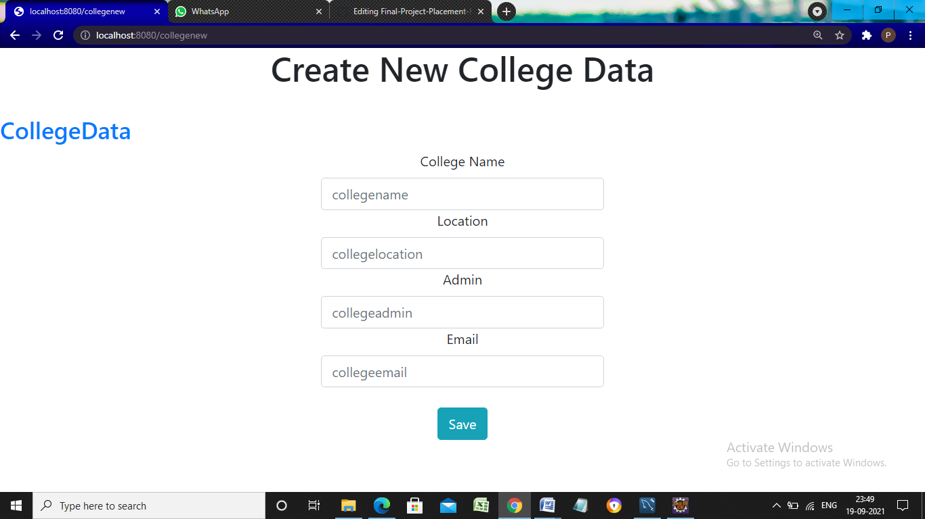
Click home it redirects to home page .click open on college details .

Slide 9
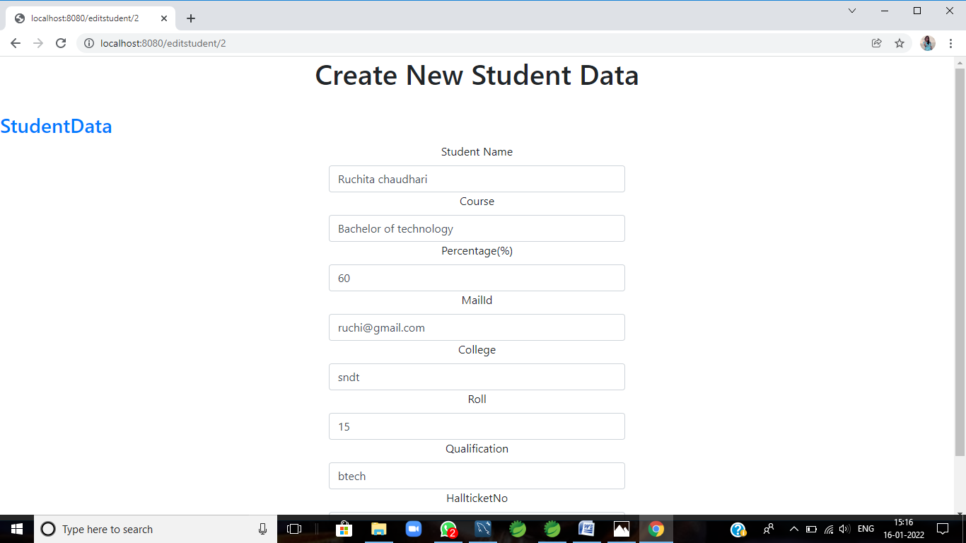
Click home it redirects to home page .click open on student details .

Slide 10
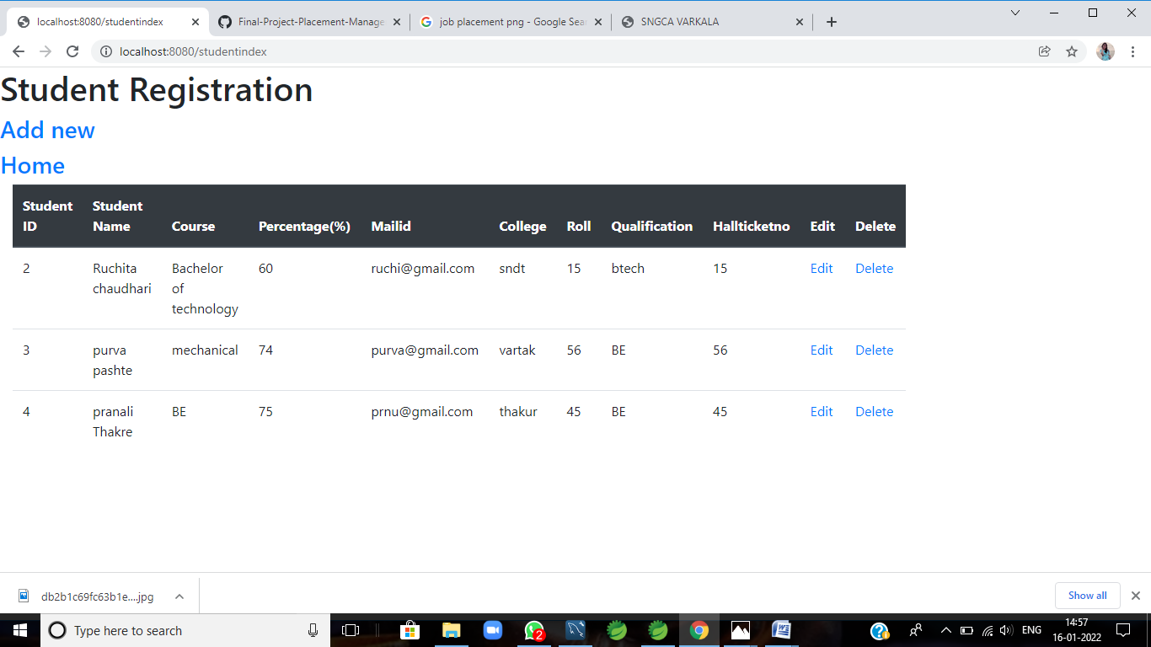
Click edit and save.
Click home, it redirects to home page and click logout.It redirects to login Page.

Slide 11
THANK YOU

